Slide 1
Air Canvas Drawing In Air using AI
Mohammed Indorewala
Shoaib Ahmed
Mohammed Abdul Irfan
Palak Patel

Slide 2
Introduction
1

Slide 3
Introduction
Our project is aimed at transforming the traditional whiteboard into an interactive and collaborative tool. The Air Canvas is an innovative solution that combines augmented reality, computer vision, and mobile technology to create a virtual canvas where teams can work together from different locations in real-time. With Air Canvas, users can draw, write, and share their ideas on a whiteboard that exists in the virtual world.

Slide 4
ROADMAP
Project Initiation
Project Execution
Project Closure
1
3
5
2
4
Project Planning
Project Monitoring & Control

Slide 5
Project Initiation

Slide 6
Project Initiation
The project initiation phase allowed us to define the project scope and objectives and establish the necessary resources and governance structure to ensure the project's success.
In the project initiation phase of the Air Canvas project, we conducted extensive research on the market demand for interactive and collaborative tools. We found that the traditional whiteboard was still widely used in both educational and business settings But was limited by its physical and geographical constraints.
We identified an opportunity to create a virtual whiteboard that could be accessed from anywhere, and that allowed for real-time collaboration between users. This led to the development of the Air Canvas project, which aimed to combine augmented reality, computer vision, and mobile technology to create a virtual canvas where teams could work together from different locations.

Slide 7
Documents Related to Project Initiation

Slide 8
Project Planning

Slide 9
Project Planning
Project planning is crucial phase ensuring that the project runs smoothly and is completed on time and within budget. These phase focused on developing an air canvas drawing tool using AI involves defining the project scope, identifying key stakeholders, developing a project plan, assembling a project team, conducting research and analysis, and determining the deployment strategy for the tool.
During this phase, the project goals and objectives are established, and a roadmap for achieving them is created. The team is assembled, and responsibilities are assigned, timelines and budgets are set, and the overall feasibility of the project is assessed.

Slide 10
Documents related to Project Planning

Slide 11
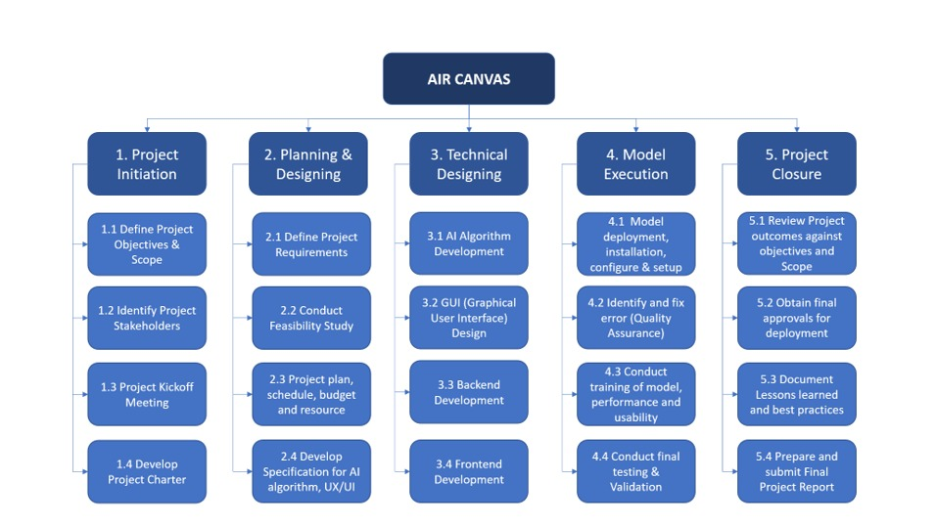
Work Breakdown Structure

Slide 12
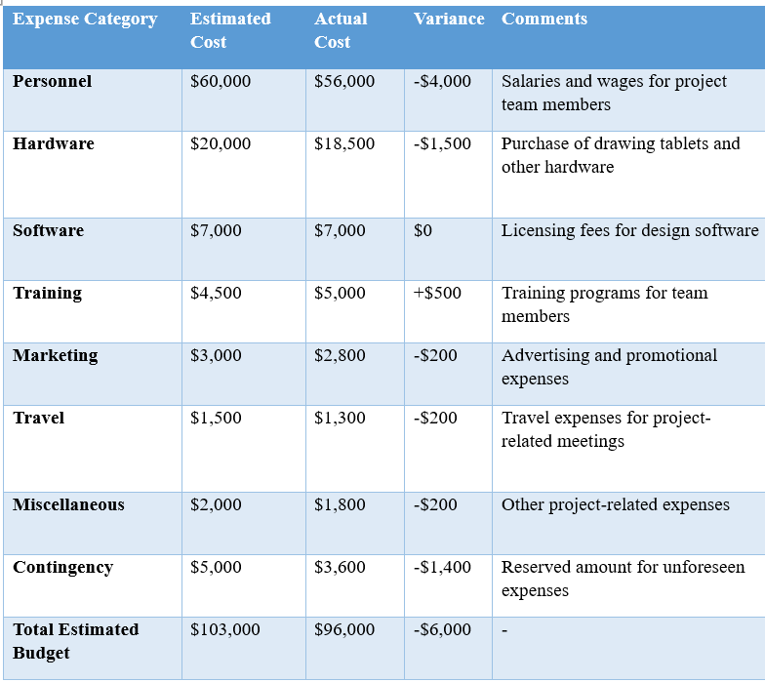
Cost & Budget

Slide 13
Project Execution

Slide 14
Project Execution Phase
During the execution stage of the air canvas drawing project, the project team will work on creating digital artwork in three-dimensional space using the specialized hardware and software identified during the initiation and planning stages. The team will use the motion-sensing device to make gestures or movements in the air, which will be translated into lines, shapes, and textures in the virtual canvas.
The project manager will oversee progress, ensure adherence to the project plan, and manage issues or changes. The team will collaborate to bring the artistic vision to life, making adjustments as needed. Regular communication and coordination among team members are crucial for smooth execution, aligning with defined scope and quality standards.

Slide 15
Documents related to Project Execution

Slide 16
Project Monitoring and Control

Slide 17
Project Monitoring and Control Phase
Monitoring and control are essential aspects of project management for an air canvas drawing project. The project manager will closely monitor the progress of the project, including tracking the timeline, budget, and scope, to ensure that the project stays on track according to the project plan.
Regular updates and reports will be generated to assess the project's status and identify any deviations from the plan. If any issues or changes arise during the execution stage, the project manager will take appropriate actions to address them and ensure that the project stays on schedule and within budget.
Control mechanisms will be in place to manage risks, quality, and scope changes effectively. Continuous monitoring and control will be critical to ensure successful project execution and achieve the desired artistic results in the air canvas drawing.

Slide 18
Documents related to Project Monitoring and Control

Slide 19
Project Closure

Slide 20
Project Closure Phase
Project closure is the final phase of an air canvas drawing project, where the project manager and the team wrap up the project and evaluate its success. The project manager will conduct a thorough review to ensure that all project deliverables have been completed and that the artistic vision has been realized according to the project scope and quality standards.
Final documentation, including project reports, lessons learned, and project closure reports, will be prepared. The team will celebrate the project's successful completion and recognize team members' contributions. A final review with stakeholders will be conducted, and the project will be formally closed, including archiving project documentation and conducting final financial and administrative activities. A post-project evaluation may also be conducted to identify areas of improvement for future projects. Project closure is a critical step to ensure that the air canvas drawing project is completed successfully and that all project activities are concluded in an organized and efficient manner.

Slide 21
Documents related to Project Closure Phase

Slide 22
Thank You

